Slide 1
EIT x Soft Robots: project update
Week of Monday 31/05/2021

Slide 2
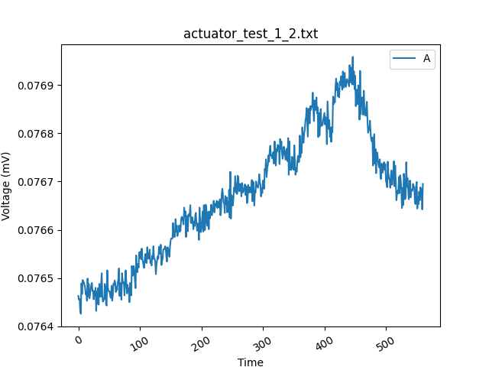
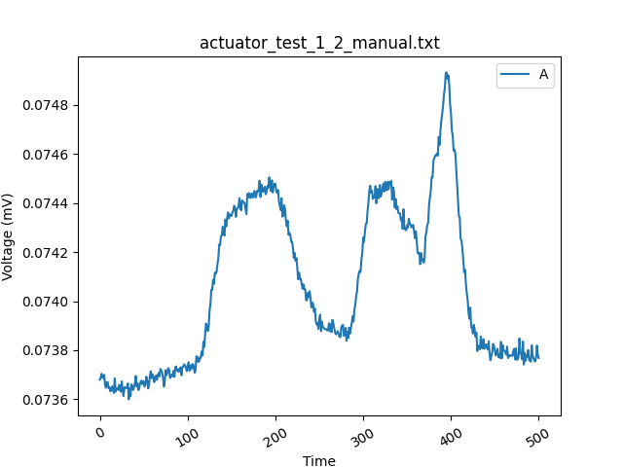
Actuator with anterior EIT chamber
Actuated, but not enough change to see difference
Noise?
Actuated to 22.5°
Actuated to 22.5°
Voltage reading over a 60ml pneumatic actuation (10ml at a time, ~1-2s per 10ml)

Slide 3
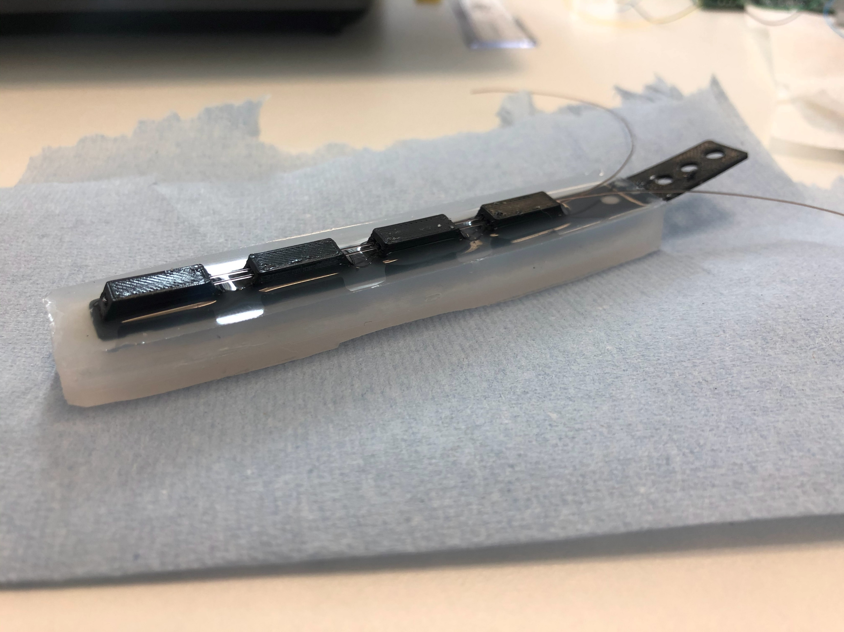
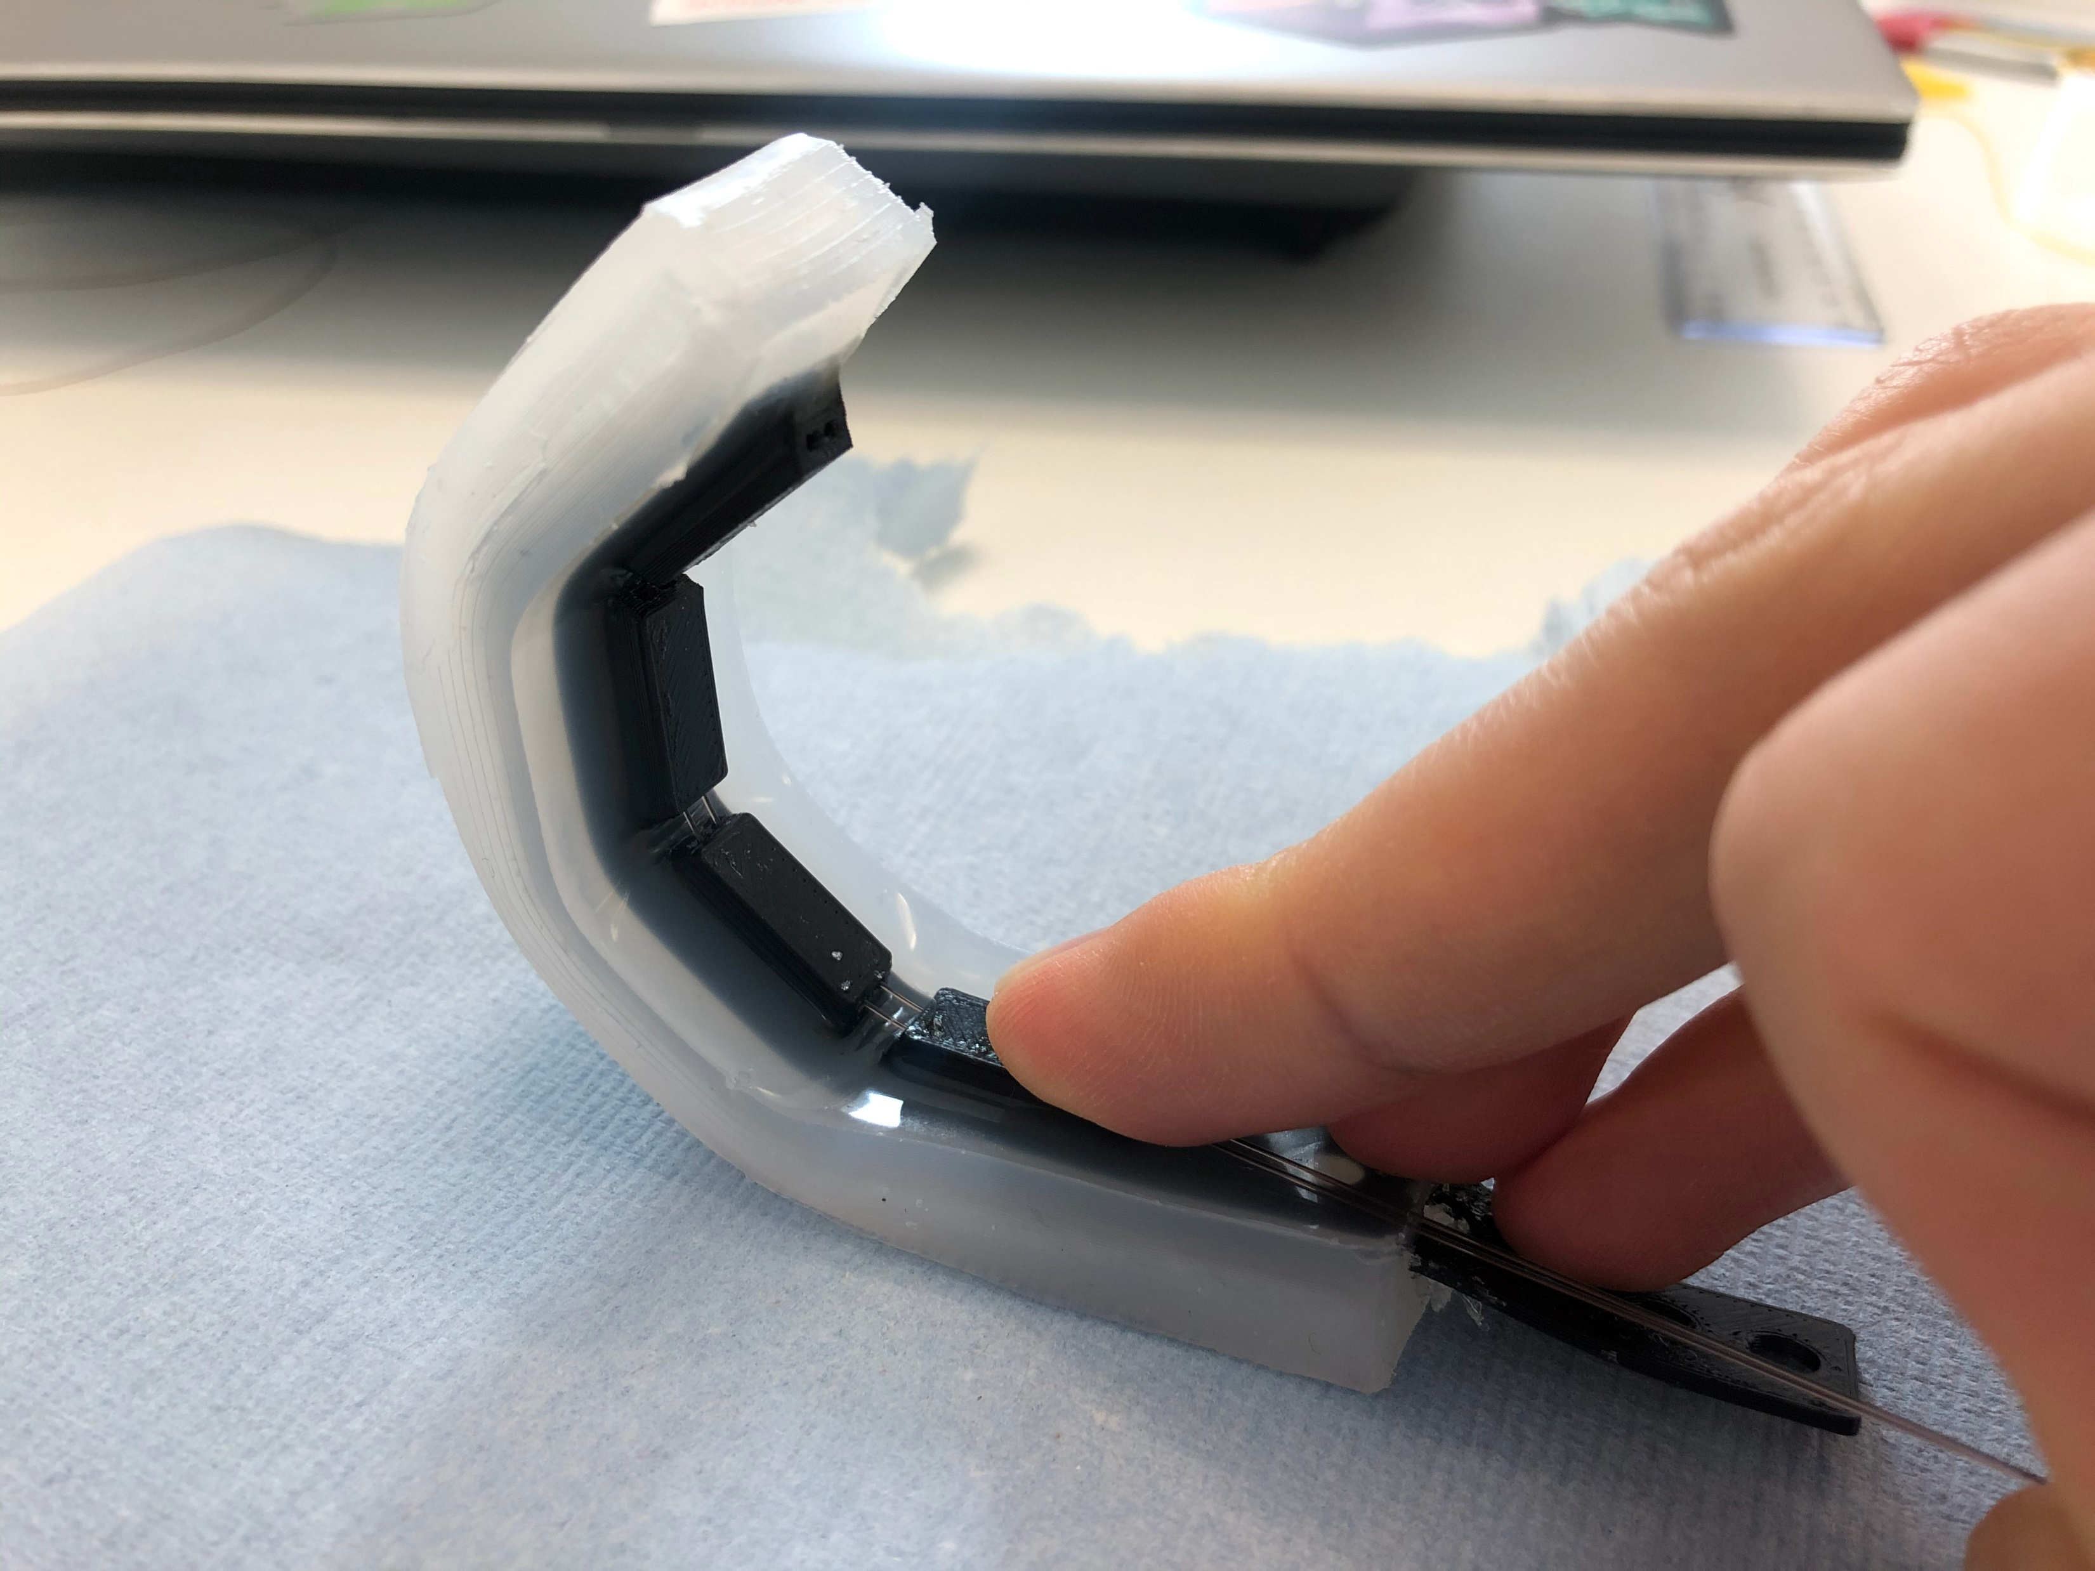
SDM actuator with EIT chamber
Cable-driven flexible “bone”
Saline chamber
Saline chamber
Cables

Slide 4
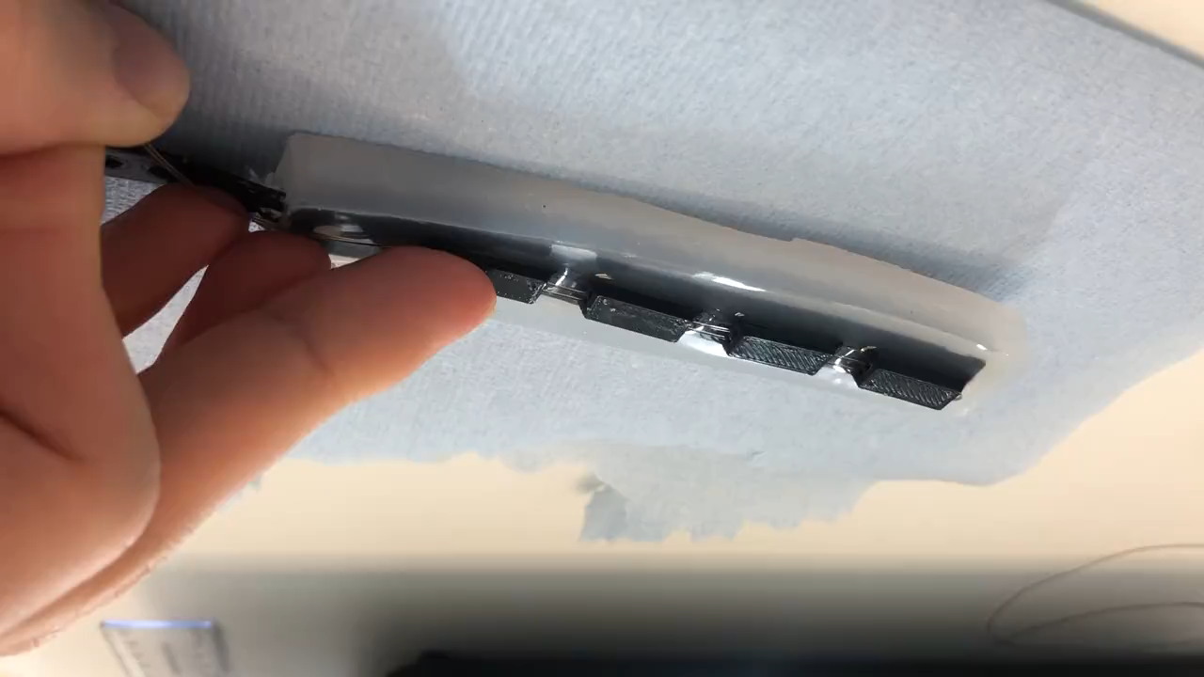
SDM actuator with EIT chamber

Slide 5
EIT data from SDM actuator
to be acquired

